Slide 1
US Airline Flight Routes and Fares 1993-2024
William Millen, Muhammad Fouly, Mohammad Saatialsoruji

Slide 2
Our goals
1: Understand Market Trends:
Goal: Analyze air travel demand trends over the past three decades to identify key growth patterns and fluctuations in the industry.
Purpose: To better understand how passenger volumes have evolved and what factors drive demand in the air travel market.
2: Evaluate Airline Performance:
Goal: Assess the performance of different airlines in terms of passenger volumes and market share.
Purpose: To determine which airlines are dominant and how competition has shaped the market.
3: Predict Future Travel Behavior:
Goal: Study changes in travel behavior over time to anticipate future trends in air travel demand and passenger preferences.
Purpose: To help airlines and policymakers prepare for future shifts in the market.

Slide 3
Timeline
Saturday
10AM
12PM
12:30PM
3PM
Used Tableau Prep Builder to clean data
Created a Kaggle API key to import data and analyze in Python
Started making a website to display our findings
Learned SAS Viya to further analyze our dataset
Sunday
5PM - 11PM
8AM
10:30
Fine tuned our website
Revised graphs and added section for old graphs
Added finishing touches and submit

Slide 4
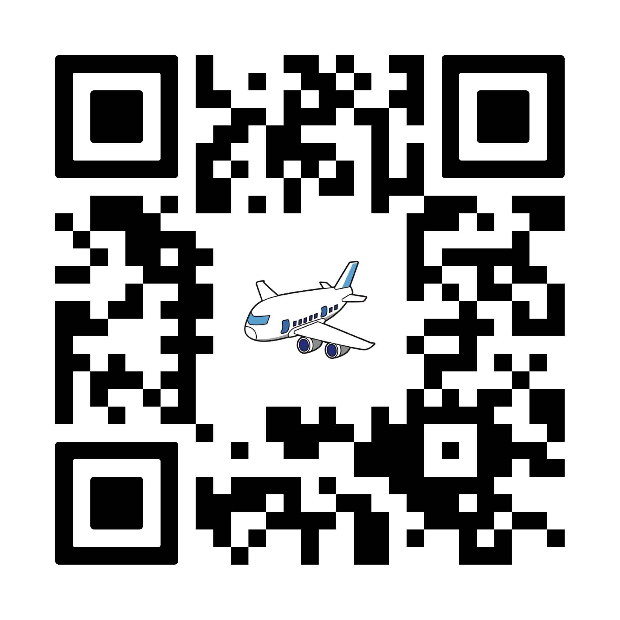
Let’s view the website!

Slide 5
THANKS!
Do you have any questions?
https://cdc2024.github.io/CDC24/

